Slide 1


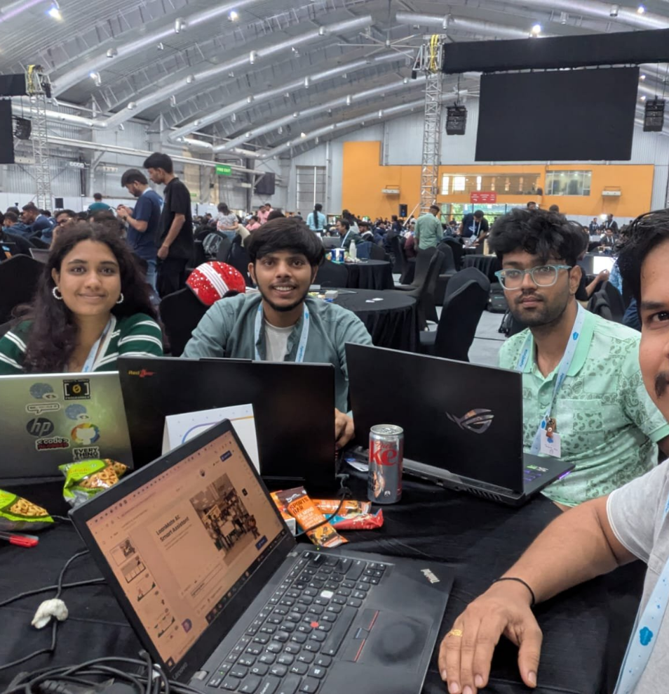

LoanMate AI: Smart Intent Detection
An innovative AI tool for understanding customer intents and assisting with loans.
Team : Lightning Boltz

Slide 2

LOAN ASSISTANT
Introducing LoanMate AI
Enhancing user experience in financial services with intelligent assistance.

Slide 3

Streamlining Loan Applications
Natural Language Queries
Users can interact with LoanMate AI using natural language, simplifying inquiries about loans.
Agent force Intent Detection
This technology classifies user intent to determine the appropriate loan service required.
Automated Case Creation
LoanMate AI automatically creates and routes cases to agents based on user queries, improving response times.
User Intent Classification
The system extracts relevant details like loan type and purpose from user queries to assist effectively.

Slide 4






Enhancing Banking with AI
01
User Intent Understanding
LoanMate AI effectively understands user intent, ensuring accurate interpretation of customer needs, leading to enhanced service delivery.
02
Automated Case Generation
By auto-generating cases for agents, LoanMate AI streamlines case creation, allowing human agents to focus on more complex tasks.
03
Knowledge Article Suggestions
LoanMate AI suggests relevant knowledge articles, improving user support and education, which enhances overall customer satisfaction.
04
Reduced Manual Intake
The solution reduces manual intake, significantly lowering the workload on human agents and improving operational efficiency.
05
Hybrid Customer Support
LoanMate AI supports AI + human help, facilitating a hybrid approach that combines the strengths of both AI and human agents.

Slide 5


LoanMate AI Mission & Vision
LoanMate AI Mission
LoanMate AI Vision
Revolutionize the loan application process
Integrate intelligent assistance
Make financial services accessible
Provide a user-friendly interface
Enhance efficiency for all users
Leverage advanced AI capabilities

Slide 6
Next Steps for LoanMate AI
User Testing
Technical Architecture
Marketing Strategy
Implementation Timelines
Conduct user testing to gather feedback on the interface, ensuring it meets user expectations and usability standards.
Finalize the technical architecture and ensure smooth integration with Salesforce for enhanced functionality and performance.
Develop a comprehensive marketing strategy to effectively promote the LoanMate AI solution to potential users and stakeholders.
Set clear timelines for implementation and deployment, aligning all teams on project milestones and deliverables.

Slide 7


Transform Your Loan Experience
Join us in revolutionizing the loan application process through innovative AI solutions.
Address
Insert Address
Phone Number
Insert Phone Number
Email
Insert Email
Date
Insert Date
Time
Insert Time
Website
Insert Website

Slide 8

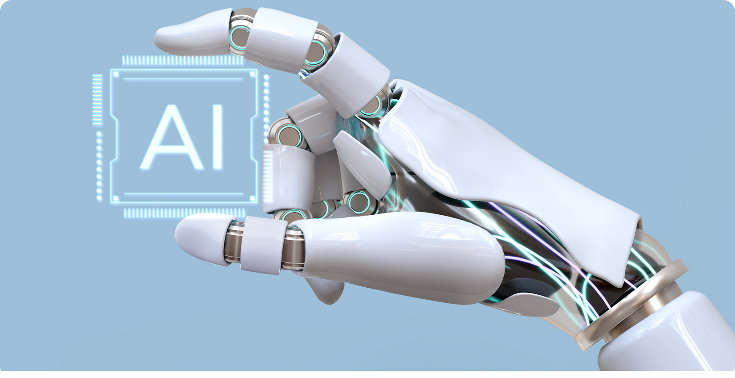


Thank You for Your Attention
We invite your questions and insights regarding LoanMate AI.

